Slide 1
Classification using Decision Tree
Presented by:
Anujay Jain
Nihit Jain
Utkarsh Rai

Slide 2
Contents
Business Understanding
Data Understanding
Data Pre-processing
Modelling
Evaluation

Slide 3

Business Understanding
Customer churn refers to when a customer (player, subscriber, user, etc.) ceases his or her relationship with a company.
Online businesses typically treat a customer as churned once a particular amount of time has elapsed since the customer’s last interaction with the site or service.
The full cost of customer churn includes both lost revenue and the marketing costs involved with replacing those customers with new ones.
Reducing customer churn is a key business goal of every online business.

Slide 4
Data Understanding
Dataset includes telecom data of 3333 customers
Data includes 21 variables namely:
State, Account Length, Area Code, Phone, Int'l Plan, VMail Plan, VMail Message, Day Mins, Day Calls, Day Charge, Eve Mins, Eve Calls, Eve Charge, Night Mins, Night Calls, Night Charge, Intl Mins, Intl Calls, Intl Charge, CustServ Calls, Churn?

Slide 5
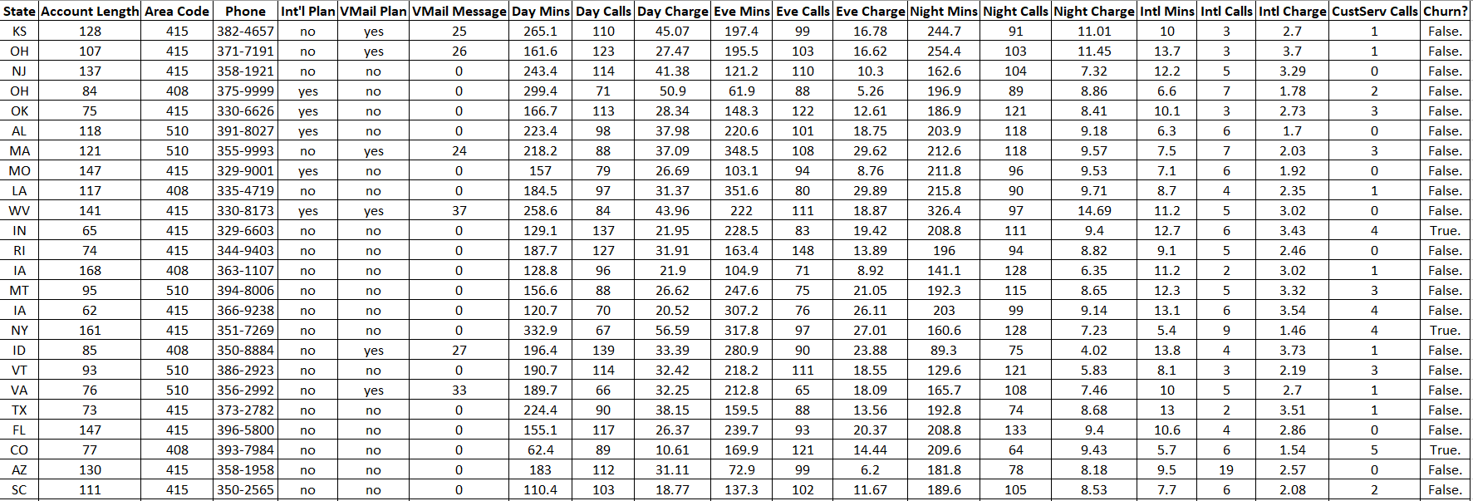
Dataset

Slide 6
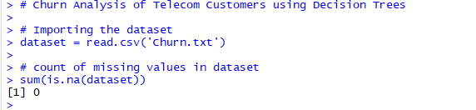
Data Pre-processing
No Missing Values were found in the dataset

Slide 7
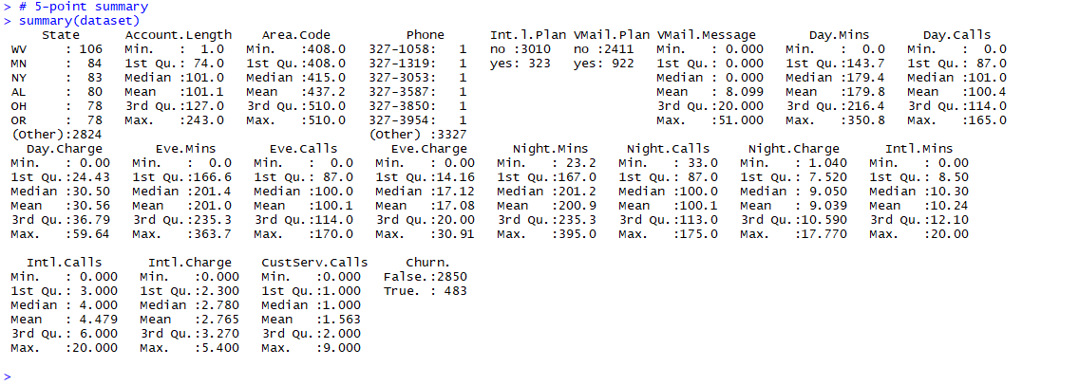

Slide 8
Modeling

Slide 9
Evaluation

